Slide 1
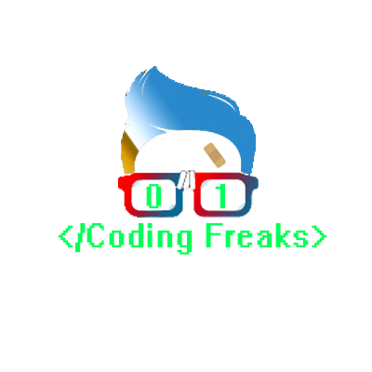
object oriented programming
- Programming paradigm

Slide 2
Introduction To OOP
Object Oriented programming (OOP) is a programming paradigm that relies on the concept of classes and objects.
It is used to structure a software program into simple, reusable pieces of code blueprints (usually called classes), which are used to create individual instances of objects.
There are many object-oriented programming languages including JavaScript, C++, Java, and Python.

Slide 3
What Is A Class?
A class is an abstract blueprint used to create more specific, concrete objects.
Classes often represent broad categories, like Car or dog that share attributes.
These classes define what attributes an instance of this type will have, but not the value of those attributes for a specific object.
Classes can also contain functions, called methods available only to objects of that type. These functions are defined within the class and perform some action helpful to that specific type of object.
Example – Color is a class which will represent colors.

Slide 4
What Is An Object?
Objects are instances of classes created with specific data.
Every real world entity is an object.
Example – Red is a example or Object of color Class

Slide 5
Benefits Of OOP
OOP models complex things as reproducible, simple structures
Reusable, OOP objects can be used across programs
Allows for class-specific behavior through polymorphism
Easier to debug, classes often contain all applicable information to them
Secure, protects information through encapsulation

